Slide 1
ECONOMIC INTEGRATION
THROUGH
MINING & RESOURCE MOBILIZATION
Hervinder Singh
Sr. Vice President - Mining

Slide 2
Mining
Accounts for 4.3% of World GDP (2011)
Provides Direct Employment to 2.5 million people worldwide.
Indirect Employment to 20-24 million Worldwide
Occupies a primary position at the start of the resource supply chain
Plays a growing role in the economy of many low and middle income countries
Foreign exchange earnings from mining increasingly creates positive developmental effects
In many countries, the mining and metals industry is gaining recognition as an important contributor to the critical policy objectives of job creation and poverty reduction

Slide 3
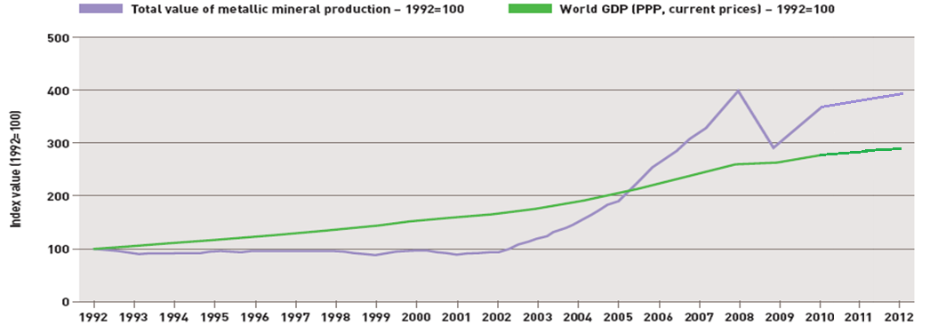
Mining Has Shown High Continual Growth in the last decade
In 2012, the nominal value of world mineral production was nearly four times than it had been in 2002.”
Source: ICMM

Slide 4
High Growth in Mining : An Anomaly?
World GDP Growth has lagged Growth in Mining in the last decade
Key Questions
Was the growth Due to Pent Up Demand ?
Has Excess Capacity been Created in the Process Industry ?
Will Supply outstrip demand in near future creating downward pressure on the Mining Industry?
?
?
?

Slide 5
Projected Growth of Major Minerals shows an increasing trend
Ore Production (MT)
Source: RMG

Slide 6
Value of Global Mining Industry: USD 3 Trillion*
Non Fuel Mining Production Value : USD 474 Billion (16% of Total Industry)
Top 20 countries accounted for 88% of total production
MINING IS A CONCENTRATED INDUSTRY : DEPENDENCE ON FEW PRODUCING COUNTRIES
 | 2010 Production value (current US$ Billion) | 2010 Production value | 2000 Production value (current US$ million) | 2000 Production value | Change in Production Value 2000-2010 | 2010 Prod Value as % of GDP | 2000 Prod Value as % of GDP | 2010 Mineral Export Contribution
1 Australia | 72.0 | 15.6% | 16.4 | 14.7% | 337.8% | 7.8% | 3.9% | 40.3%
2 China | 69.3 | 15.0% | 10.6 | 9.4% | 555.1% | 1.2% | 0.9% | 1.5%
3 Brazil | 47.0 | 10.2% | 7.8 | 6.9% | 506.5% | 2.3% | 1.2% | 19.0%
4 Chile | 31.3 | 6.8% | 10.5 | 9.3% | 199.2% | 14.7% | 13.9% | 65.9%
5 Russian Federation | 28.7 | 6.2% | 10.8 | 9.6% | 166.1% | 1.9% | 4.1% | 6.6%
6 South Africa | 27.1 | 5.9% | 12.7 | 11.3% | 113.6% | 7.5% | 9.6% | 37.4%
7 India | 26.0 | 5.6% | 2.9 | 2.6% | 788.8% | 1.5% | 0.6% | 17.9%
8 United States | 23.0 | 5.0% | 11.3 | 10.0% | 104.0% | 0.2% | 0.1% | 6.2%
9 Peru | 18.8 | 4.1% | 4.7 | 4.2% | 302.2% | 12.0% | 8.8% | 62.7%
10 Canada | 14.0 | 3.0% | 7.9 | 7.0% | 78.1% | 0.9% | 1.1% | 11.9%
11 Indonesia | 12.2 | 2.6% | 4.9 | 4.4% | 147.1% | 1.7% | 3.0% | 10.6%
12 Ukraine | 9.3 | 2.0% | 1.8 | 1.6% | 413.6% | 6.7% | 5.8% | 8.2%
13 Mexico | 8.4 | 1.8% | 2.4 | 2.2% | 244.6% | 0.8% | 0.4% | 4.9%
14 Kazakhstan | 7.2 | 1.6% | 2.4 | 2.1% | 203.3% | 4.9% | 13.1% | 13.1%
15 Iran, Islamic rep. | 4.4 | 0.9% | 0.8 | 0.7% | 446.8% | 1.3% | 0.8% | 3.7%
16 Philippines | 4.2 | 0.9% | 0.4 | 0.4% | 964.1% | 2.1% | 0.5% | 6.8%
17 Sweden | 4.0 | 0.9% | 1.1 | 0.9% | 275.5% | 0.9% | 0.4% | 5.3%
18 Ghana | 4.0 | 0.9% | 1.0 | 0.9% | 290.4% | 12.7% | 20.4% | 25.4%
19 Zambia | 3.9 | 0.8% | 0.6 | 0.5% | 524.7% | 23.8% | 19.0% | 83.6%
20 Papua New Guinea | 3.2 | 0.7% | 1.3 | 1.2% | 136.5% | 33.4% | 38.0% | 54.0%
Source: ICMM

Slide 7
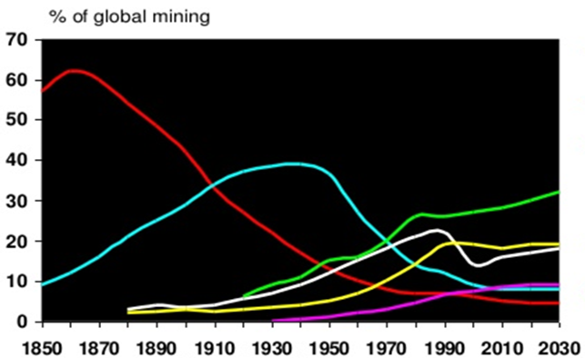
How the Future of Mining Industry Looks ?
Developing Economies to play increasingly important role
Europe
USA
China
USSR / CIS
Australia / Canada
Resource Rich Countries
Incl. Brazil, India, Mexico, South Africa, Guinea, other African Country
Source: RMG

Slide 8
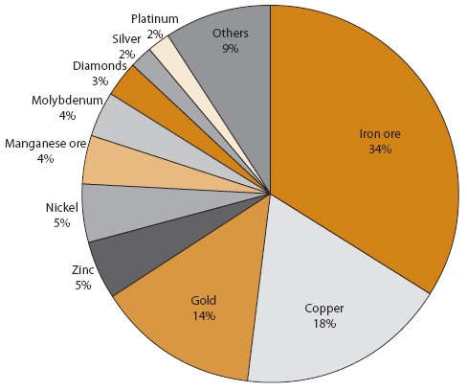
How the Future of Mining Industry Looks ?
The Indicative Trend for the Mining Industry in general remains
Upward
Economic growth of Nations
With special reference to
IRON ORE
The Most Mined Mineral in the World
Mine Production - % of total value
Source: RMG

Slide 9
Iron Ore : 50% Additional Production Required from Current Levels
2012 Demand : 1.7 Bn Ton
2035 Demand : 2.5 Bn Ton
We need about half of the probable & possible projects to meet demand in 2035
Source: RMG

Slide 10
Iron Ore : Current Market Dynamics
Brazil & Australia account for Approx. 50% of Supply
Source: World Steel

Slide 11
Increasing trend in prices
Iron Ore Price Movement (USD / Ton)
Price has increased by
681%
in the last decade
Coal Price Movement
Price has increased by
355%
in the last decade

Slide 12
Alarming Situation
Imperative to develop new sources of minerals
To reduce additional pressure on environment of major producing countries
To check price rise
To increase life of existing mines
Long term sustainability of mining sector in respective countries

Slide 13
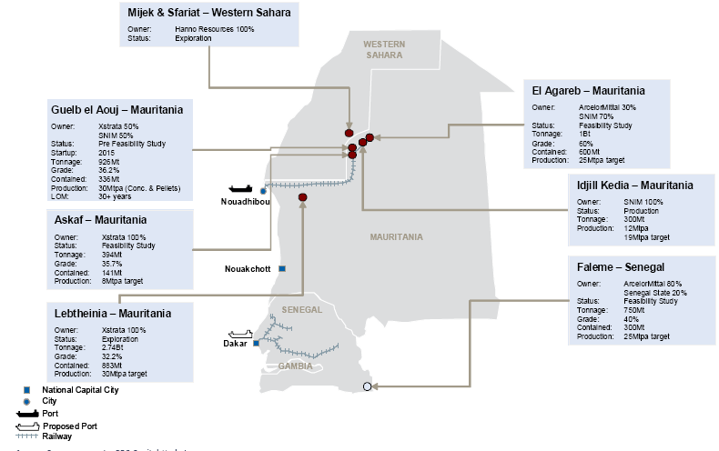
Key Iron Ore Regions & Project Statistics in North West Africa
MAURITANIA
SENEGAL

Slide 14
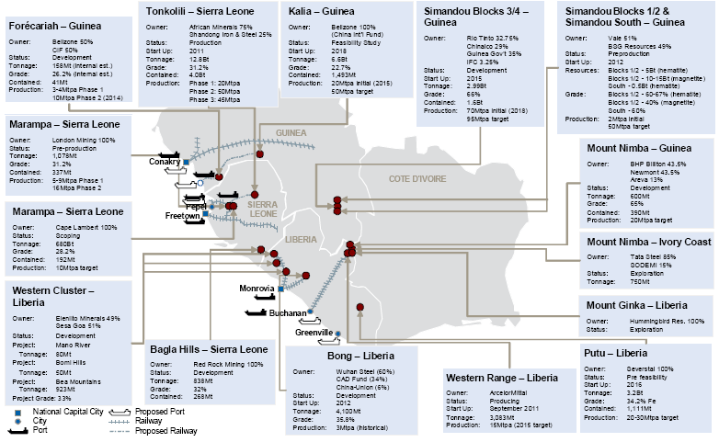
Key Iron Ore Regions & Project Statistics in West Africa
GUNIEA
COTE D’IVORE
SIERRA
LEONE
LIBERIA

Slide 15
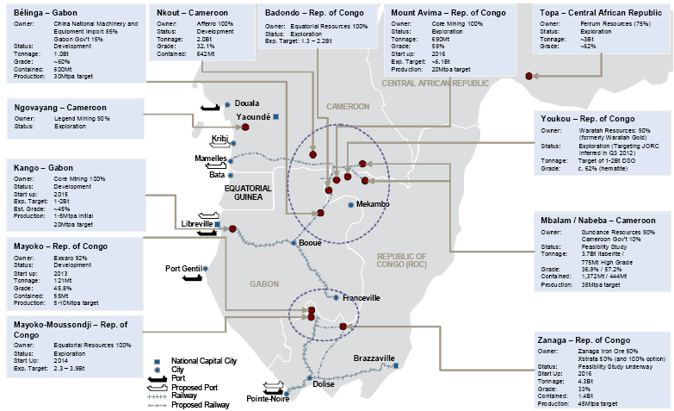
Key Iron Ore Regions & Project Statistics in Central Africa
CAMEROON
REP. OF
CONGO
GABON

Slide 16
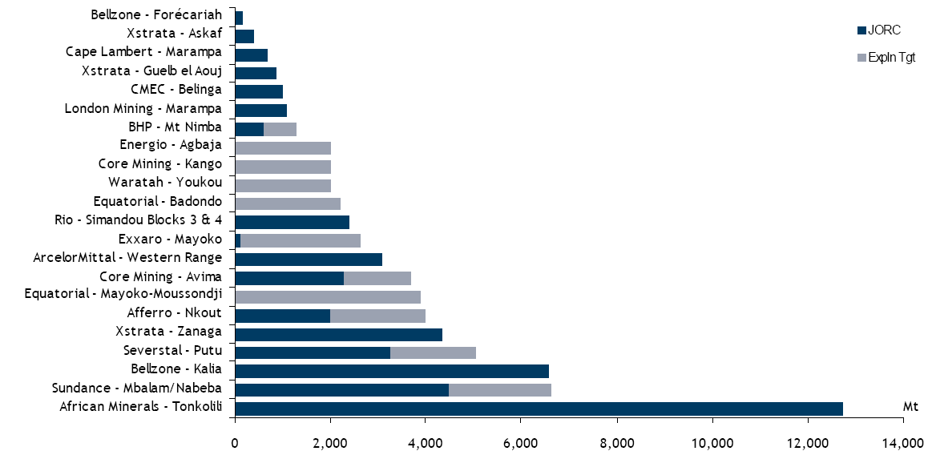
Resource Potential in Africa
Resource Potential for selected African Iron Ore Projects : 70 Bn Ton
Total Estimated Resource (approx.)
Source: RBC Cap Mkts

Slide 17
Current Iron Ore Production in Africa (MTPA)
MTPA
53.2 | 54.4 | 54 | 56.6 | 56.4 | 63.2 | 70.1 | 70.8 | 69 | 76.5
Total Production
Source: RBC Cap Mkts

Slide 18
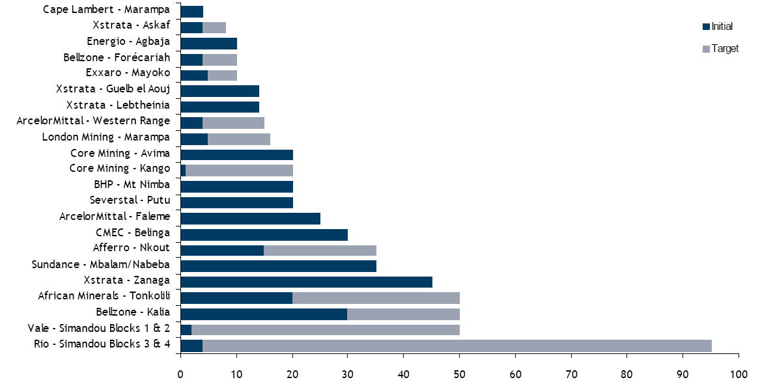
Production Target of Selected Iron Ore Projects
Initial Production of 350 MTPA increasing to over 700 MTPA in the next decade
MTPA
Source: RBC Cap Mkts

Slide 19
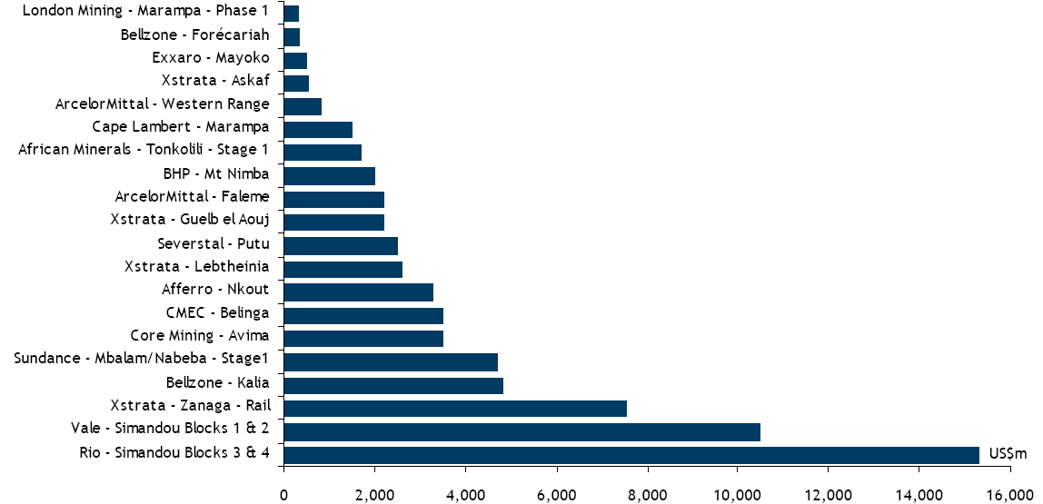
Investments of over USD 80 Bn Required
Capital Costs for selected African Iron Ore Projects
Source: RBC Cap Mkts

Slide 20
GDP has been growing with mining activity
Mining Production Value (Metallic Minerals) – USD Million
GDP (USD Billion)

Slide 21
Iron Ore : How will the Future demand be met ?
Top Producing Countries have already reached optimum capacity levels
AFRICA TO SUPPLY
25%
of WORLD PRODUCTION
in 2035
Up from 4% today
AFRICA 2012
76 MTPA
AFRICA 2035
700 MTPA
Additional Production of 625 MTPA from Africa
800% Growth from current levels
Source: RMG

Slide 22
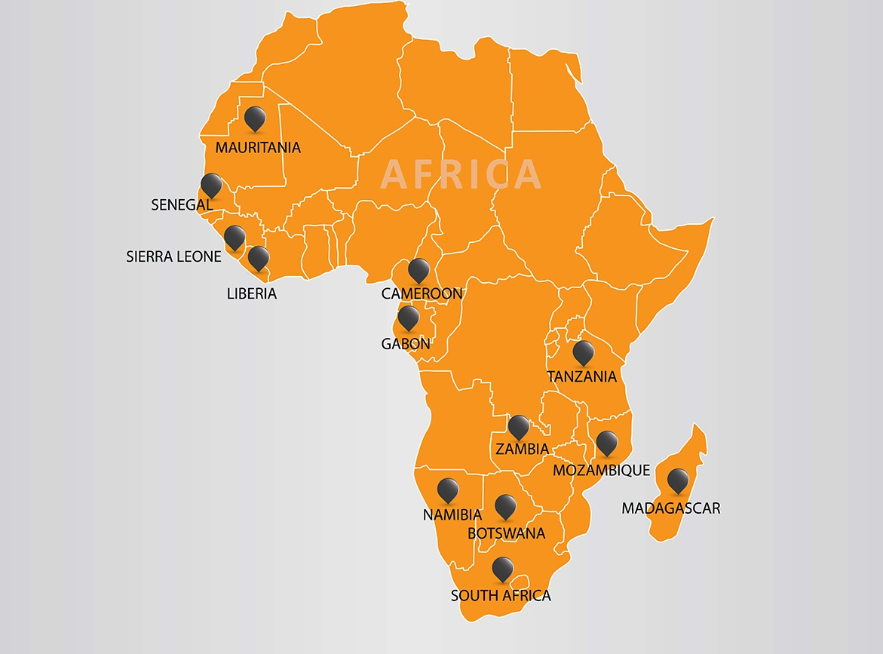
Our Presence in Africa
Iron Ore
Power
Power
Iron Ore
Power
Copper
Copper
Coal & Power
Country | Capacity | Product
Mozambique | 3 MTPA | Value Added Coal
South Africa | 1.3 MTPA | Value Added Coal
CAPEX | Over 500m USD
Manpower | +2500
Others | Exploration
Limestone
Iron Ore
Coal & Power
Iron Ore & Coal

Slide 23
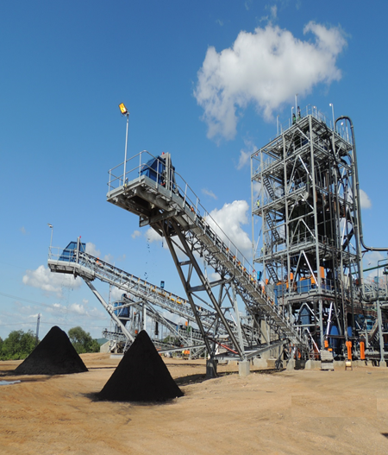
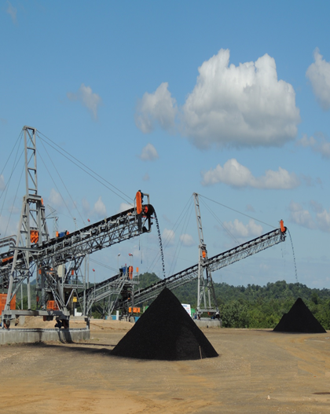
Mozambique – 3 MTPA Beneficiation Plant

Slide 24
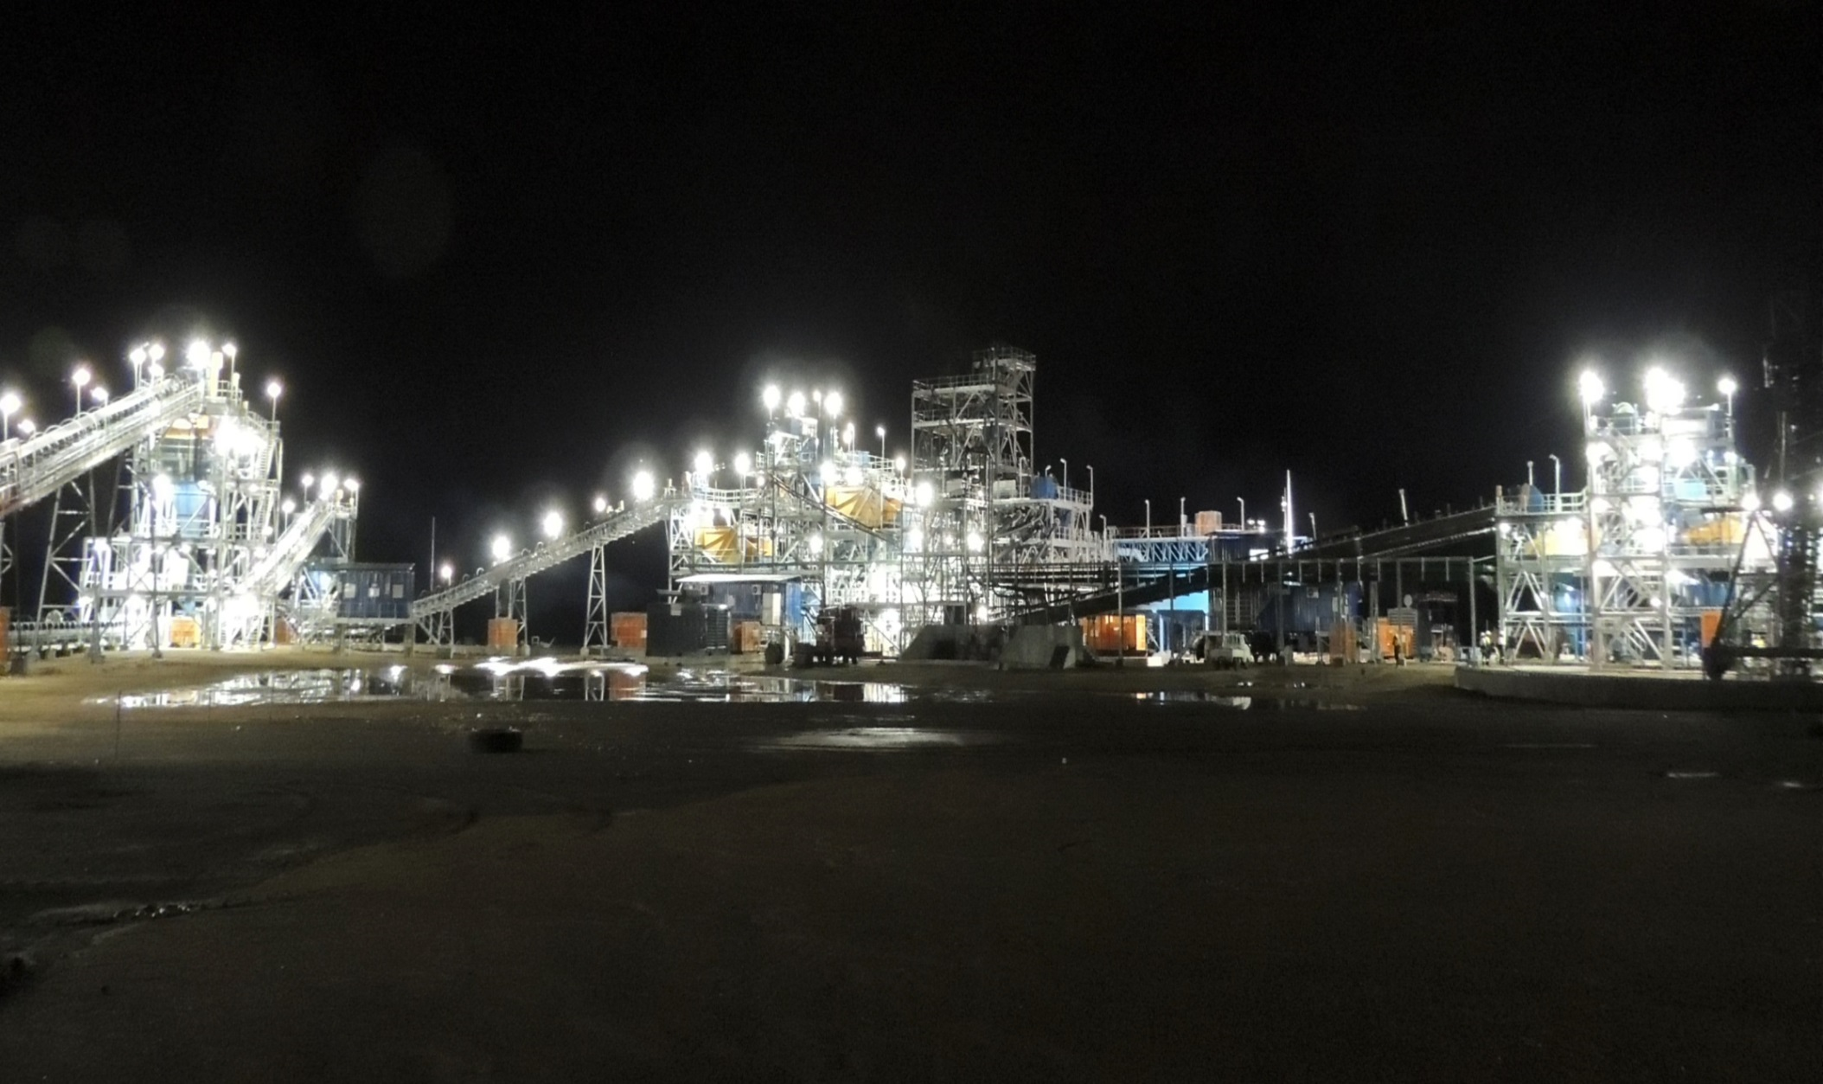
Mozambique – 3 MTPA Beneficiation Plant

Slide 25
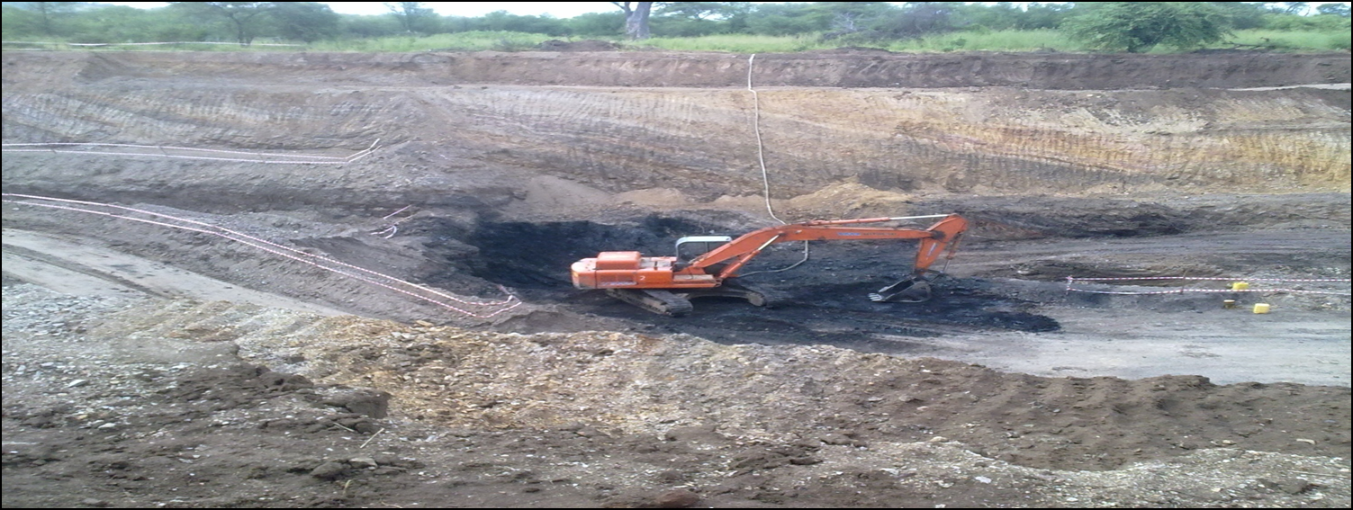
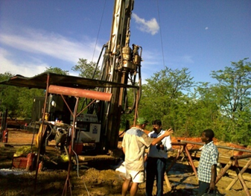
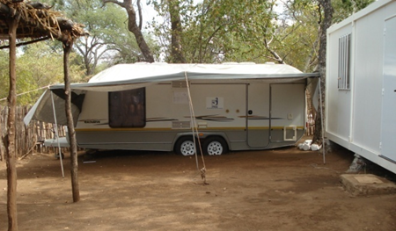
Mozambique : Working With & For Communities

Slide 26
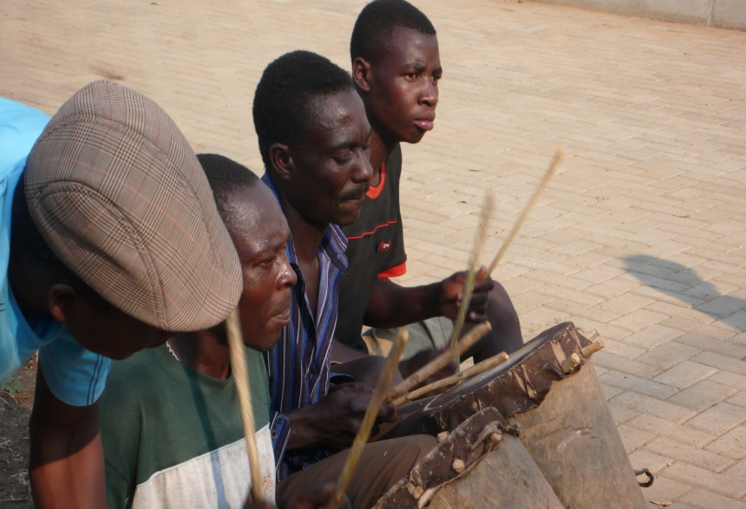
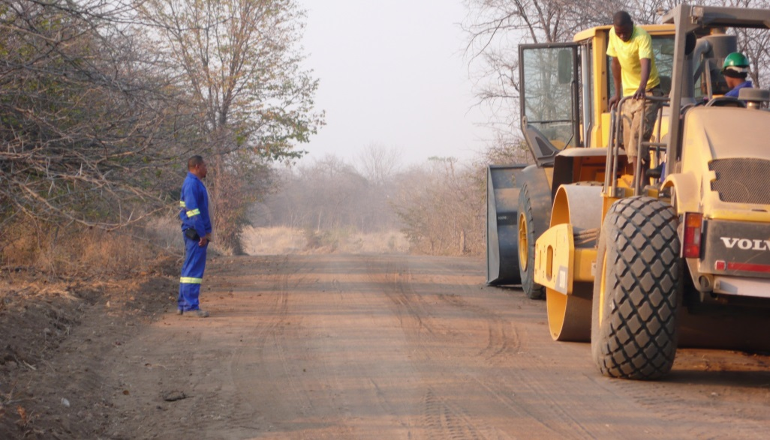
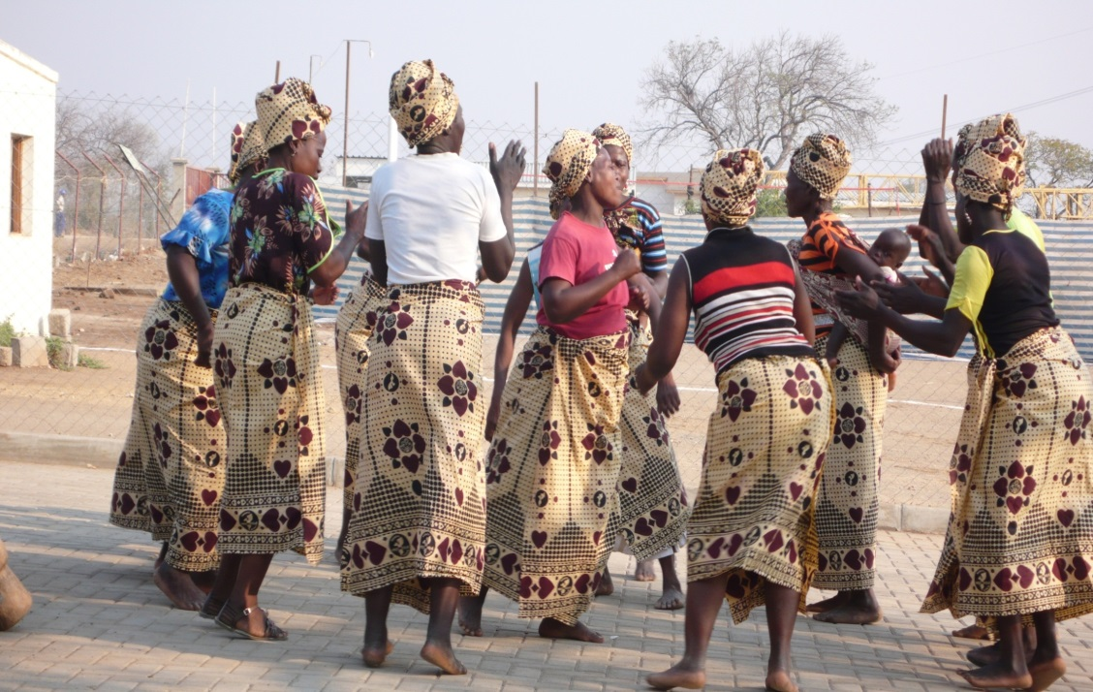
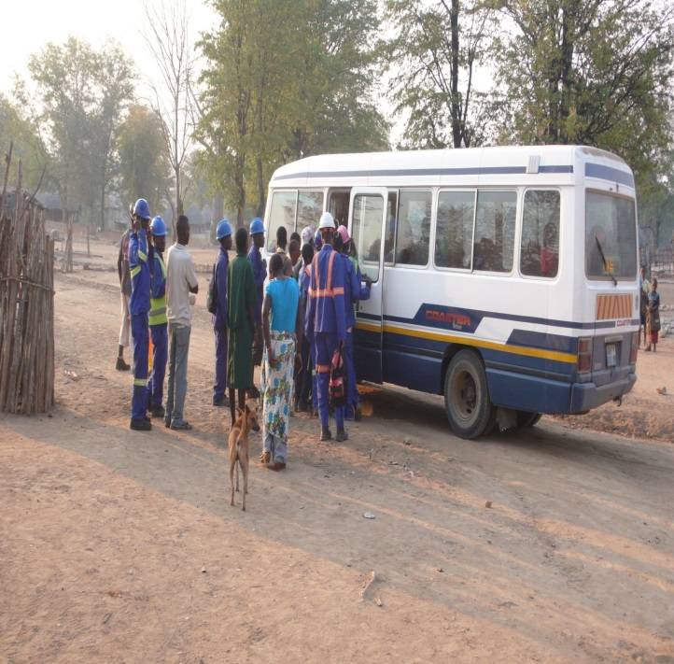
Mozambique : Working With & For Communities
Road Construction
Cultural Events
Transportation To Villagers

Slide 27
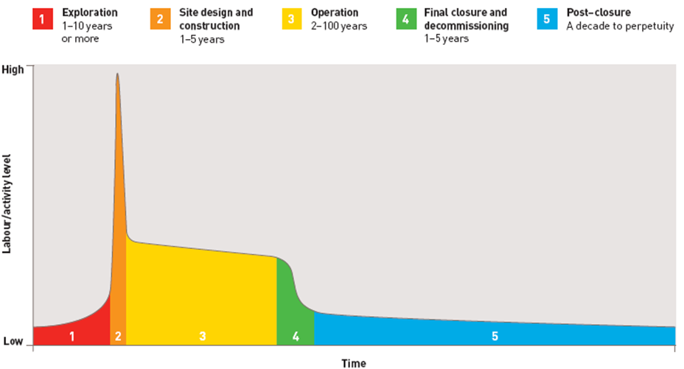
Sustainable Development & Long Term Returns
Source: ICMM

Slide 28
Socio Economic Considerations
The larger direct contributions are concentrated at the national level (FDI / GDP)
Smaller contributions (especially employment) apply to local mining communities
More disruptive effects are likely to arise in local communities
Resettlement of populations
Environmental change
and disruption of traditional livelihoods
Gap between the potential and realized contribution of mining remains
Government has an important role to play in managing these issues

Slide 29
Improving mining’s contribution to development
Harnessing of resource through partnerships between government and companies
Empowerment of communities by judicious planning of Regional development
Pro-active development of indirect jobs
Redirection of the large national benefits (Eg. Govt. Rev.) for use in local areas
Visibility of mining revenue
Improving local Skills
Transparent revenue sharing mechanisms
Pro-active procurement policy of companies, combined with training and technical assistance

Slide 30
Integration with Economy
“ Mining FDI combined with increased foreign exchange earnings can be a catalyst for some countries to improve their credit ratings and attract long-term loan funding from abroad “
Foreign direct investment (FDI)
Contribution is especially significant in low income countries, pointing to their ability to attract mining investment even when FDI into other sectors appears unattractive
Gross Domestic Product (GDP)
one dollar of economic activity in the mining sector can generate three dollars or more of economic activity elsewhere
Total national investment
Exports & Net foreign exchange earnings
Government revenues
Employment and wages
Employment multiplier effects can often be significant

Slide 31
Conclusion
Many countries in Africa are fortunate to be endowed with Natural Resource
However, it is beneficial to the country only if the value chain is captured
effectively by
Sustainable mining
Value Addition within the country
Mineral Rich Countries across the globe, who have managed mining effectively, have witnessed :
Development in Infrastructure
Growth in Industrial Activity
Growth in overall Economy
High Employment Generation (Direct & Indirect)
Most Importantly, Development in the Quality of Life
Resource Rich Africa : “ The Sleeping Giant” is waiting to be developed to its true potential
The only alternative is to mobilize these natural resources

Slide 32
THANK YOU

